Slide 1


Next POI Recommendation: GNNs for Spatiotemporal Analysis
Deep Learning Project
Artificial Intelligence and Robotics
Andrea Cadoli - Valerio Canavari - Davide Ceriola

Slide 2
Introduction
Next POI Recommendation Task
Problem: Forecast next-POI (Point Of Interest).
Challenge: The complexity of human behavior difficult accurate prediction.
Goal: Improve the accuracy of recommendation

Slide 3
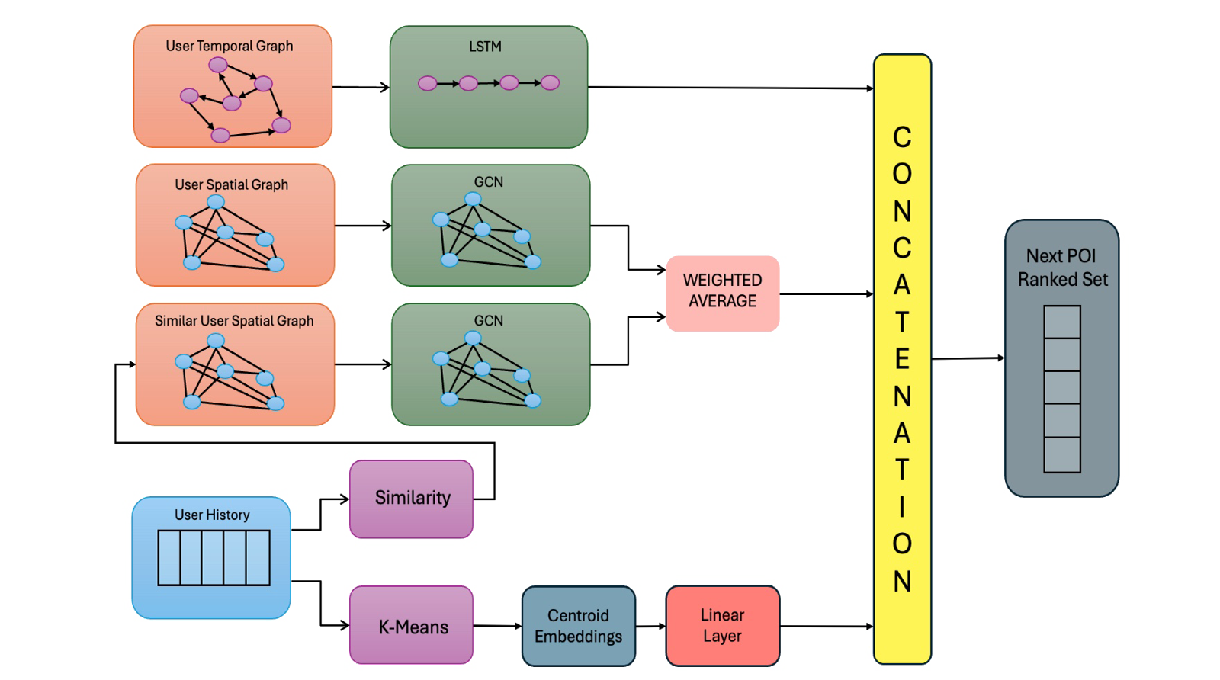
Model Architecture
Temporal Pipeline
Spatial Pipeline
Similarity Pipeline

Slide 4
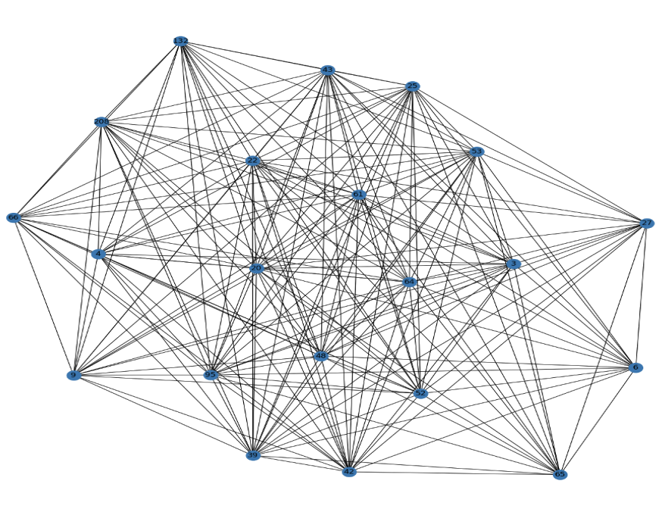
Model Architecture
Spatial Pipeline
Spatial Graph
collection of all the POIs visited by a user
Models: GCN, GAT
Goal: understand how geographical location influences user movements
Notes:
Spatial graphs represent users’ movement patterns across different POIs. The goal of this spatial analysis is to capture spatial dependencies and understand how geographic proximity influences movement decisions.

Slide 5
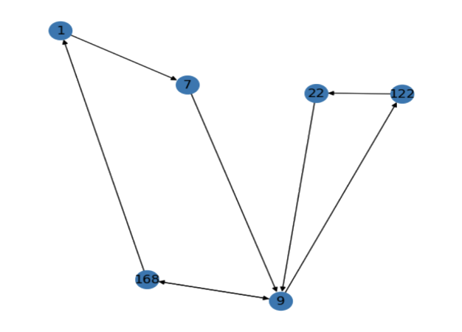
Model Architecture
Temporal Pipeline
Temporal Graphs
transition sequences between POIs in time slots
Model: LSTM
Goal: learn time-sensitive dependencies and patterns
Notes:
Temporal graphs represent user transitions sequences between POIs. They encode human mobility patterns by modeling routines, time-sensitive behaviors, and the dependencies between visited locations.
GLI DEVI PURE DIRE CHE I GRAFI TEMPORALI SONO STATI TRASFORMATI IN SEQUENZE PER LA LSTM EH
LSTM: recurrent network with memory cells that can retain relevant information over long periods (unlike the RNN). They improve the ability to predict the next POI by considering both recent and distant past events.

Slide 6
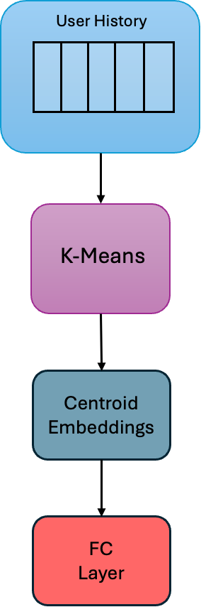
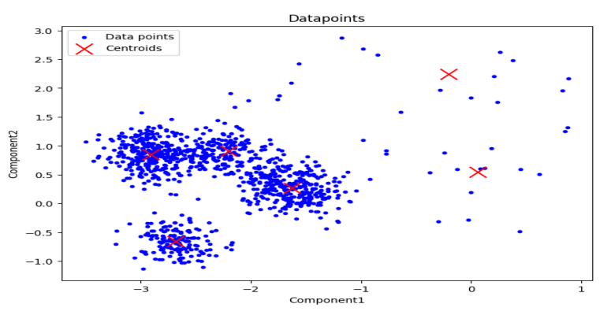
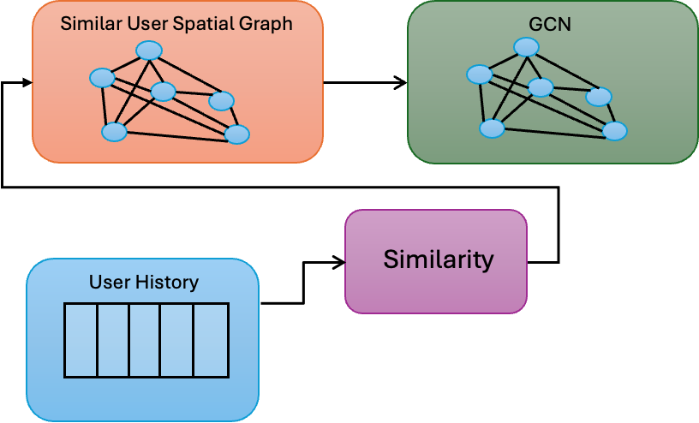
Model Architecture
Similarity Pipeline
Similarity
Users history
(Cosine) Similarity
Similar User Spatial Pipeline
K-Means
Dimensionality Reduction
Divide users in clusters
Fully connected layer
Notes:
USER SIMILARITY: cosine similarity between the history h_{i} of a user i and the histories of all other users, identifying the most similar user j. After a passage in GNN, weight average between embedded spatial graph of j and i (weights 30% and 70% respectively).
KMEANS: applying the K-Means algorithm we obtain 6 different classes based on a 2D representation of their histories (PCA reduction). Then, the embedding of each user’s assigned centroid is passed through a FC layer to integrate it with the learning process.

Slide 7
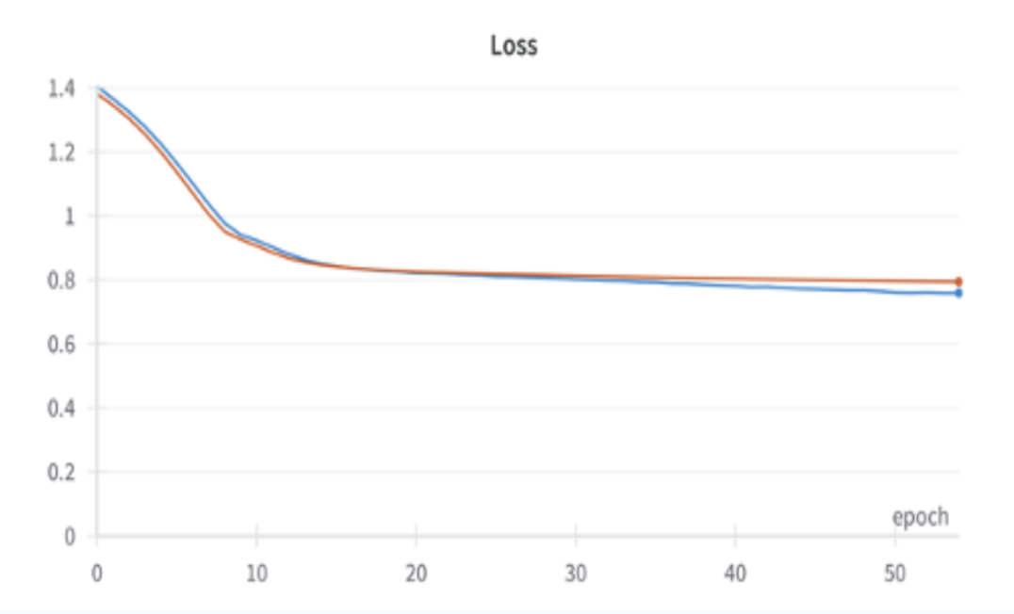
Loss Function
Combining BCE and CE
FFFF
Cross Entropy: Loss too high!
Binary Cross Entropy: Loss too low!
Solution: αBCE + βCE

Slide 8
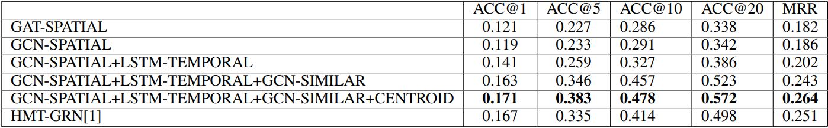
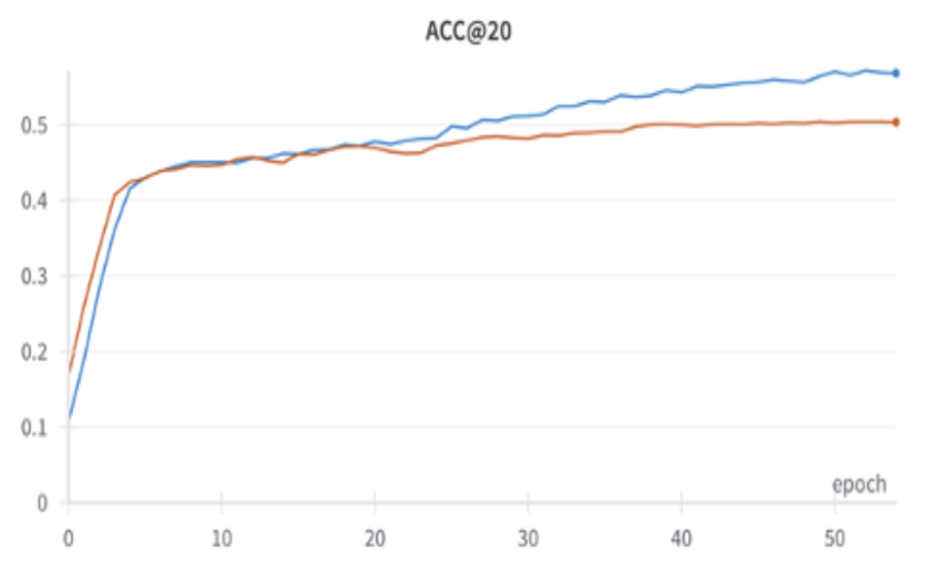
Results

Slide 9
Next POI Recommendation: GNNs for Spatiotemporal Analysis
Deep Learning Project
Artificial Intelligence and Robotics
Andrea Cadoli - Valerio Canavari - Davide Ceriola

